Slide 1
STAR-BME
Installation Guide

Slide 2
Features of STAR-BME
Display of space-time data in the GIS environment
Integration of multi-sourced space-time data(in different formats)
Incorporation of space-time data of multi-sourced uncertainties in probabilistic forms
Analysis of space-time dependence, by using empirical and mathematical spatiotemporal models
Prediction and mapping in BOTH space and time
Data export and display in multiple formats

Slide 3
Before installing STAR-BME
STAR-BME can only run in
  QGIS 3.16.8 for Windows
  QGIS 3.16.1 for Mac
Install the corresponding version before installing STAR-BME.
  The download link are provided in NTUCool.
  You don’t need to uninstall QGIS you’ve installed.

Slide 4
Install STAR-BME
It is almost the same for Windows and Mac from Step 1 to Step 6.

Slide 5
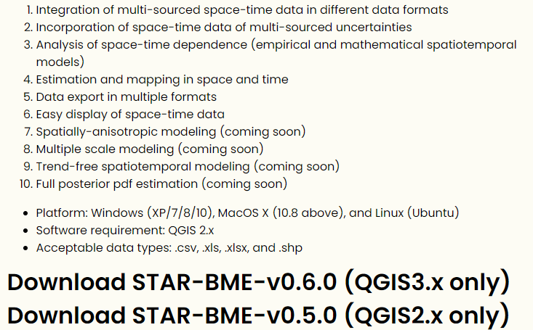
Install STAR-BME
STEP 1: Download STAR-BME
  https://stemlab.bse.ntu.edu.tw/blog/2019-04-23-star-bme/

Slide 6
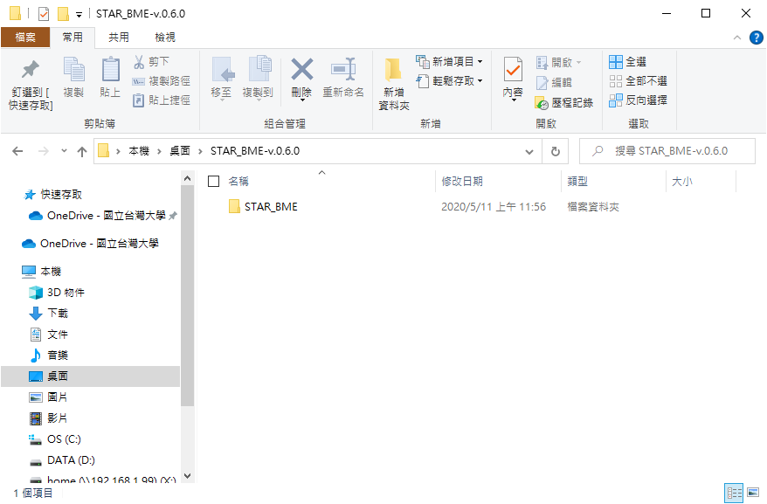
Install STAR-BME
STEP 2: Unzip the file and open the folder.

Slide 7
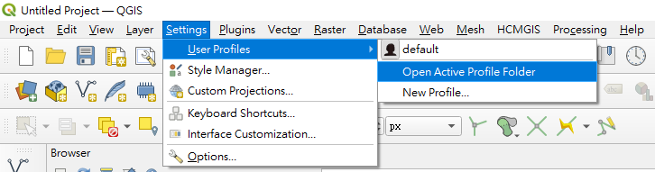
Install STAR-BME
STEP 3: Open QGIS
  Settings → User Profiles → Open Active Profile Folder

Slide 8
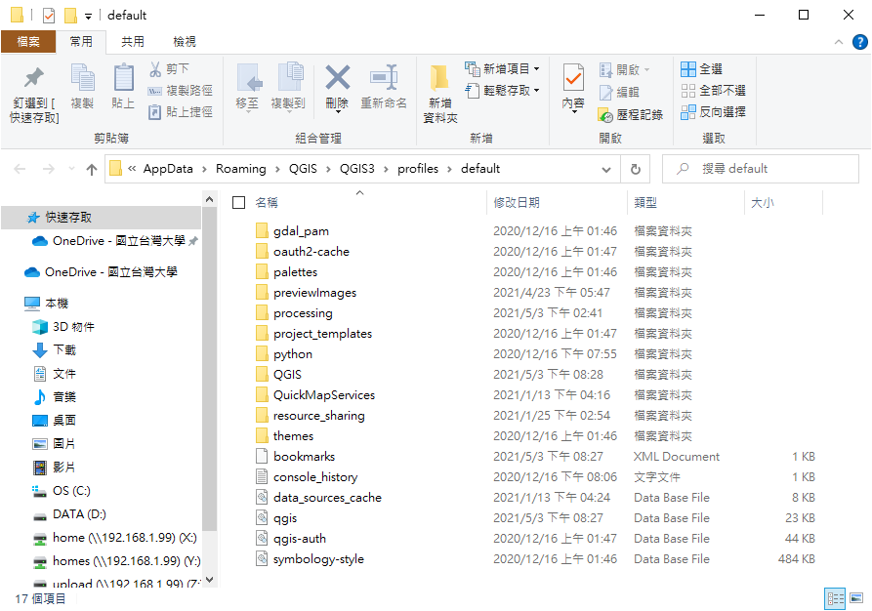
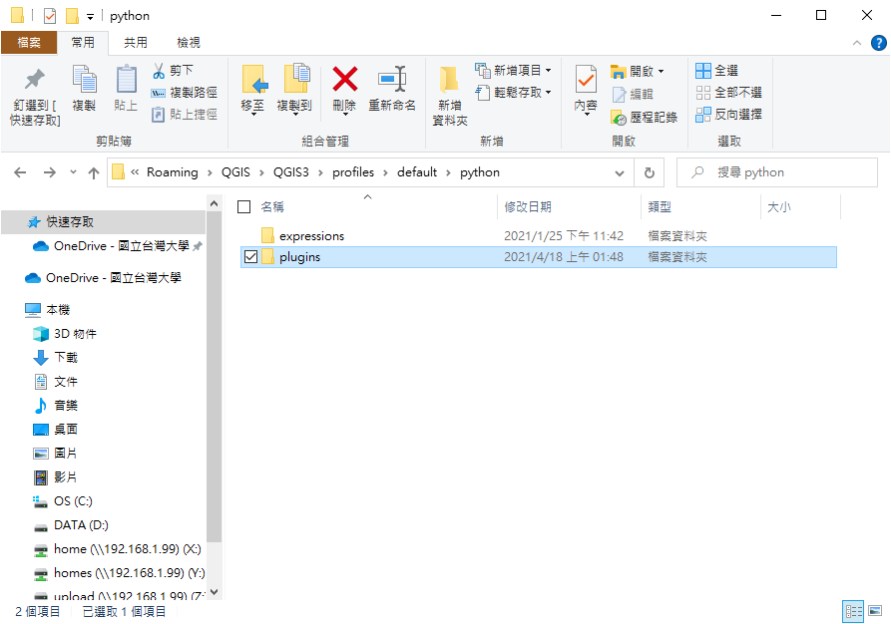
Install STAR-BME
STEP 4: Go into python → plugins

Slide 9
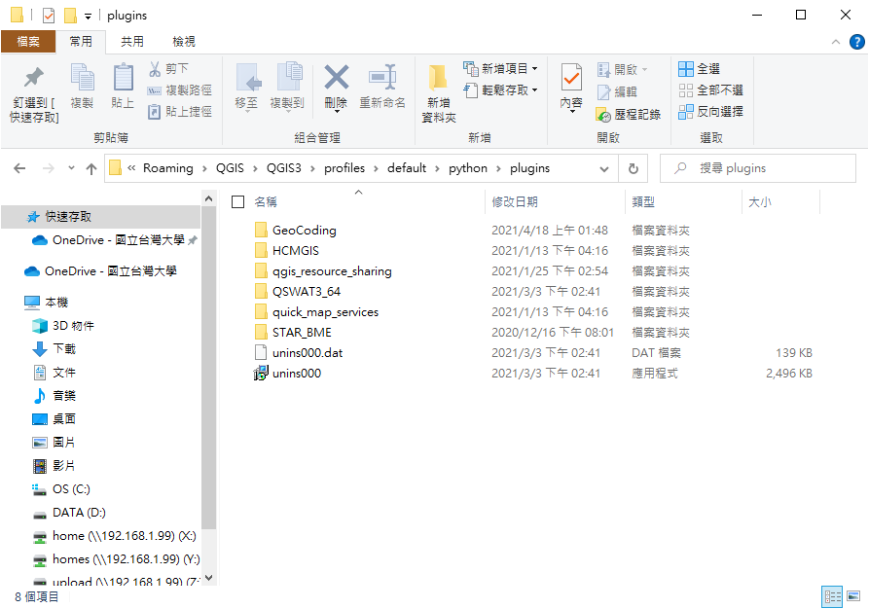
Install STAR-BME
STEP 5: Copy the “STAR_BME” folder and paste it into the “plugins” folder.

Slide 10
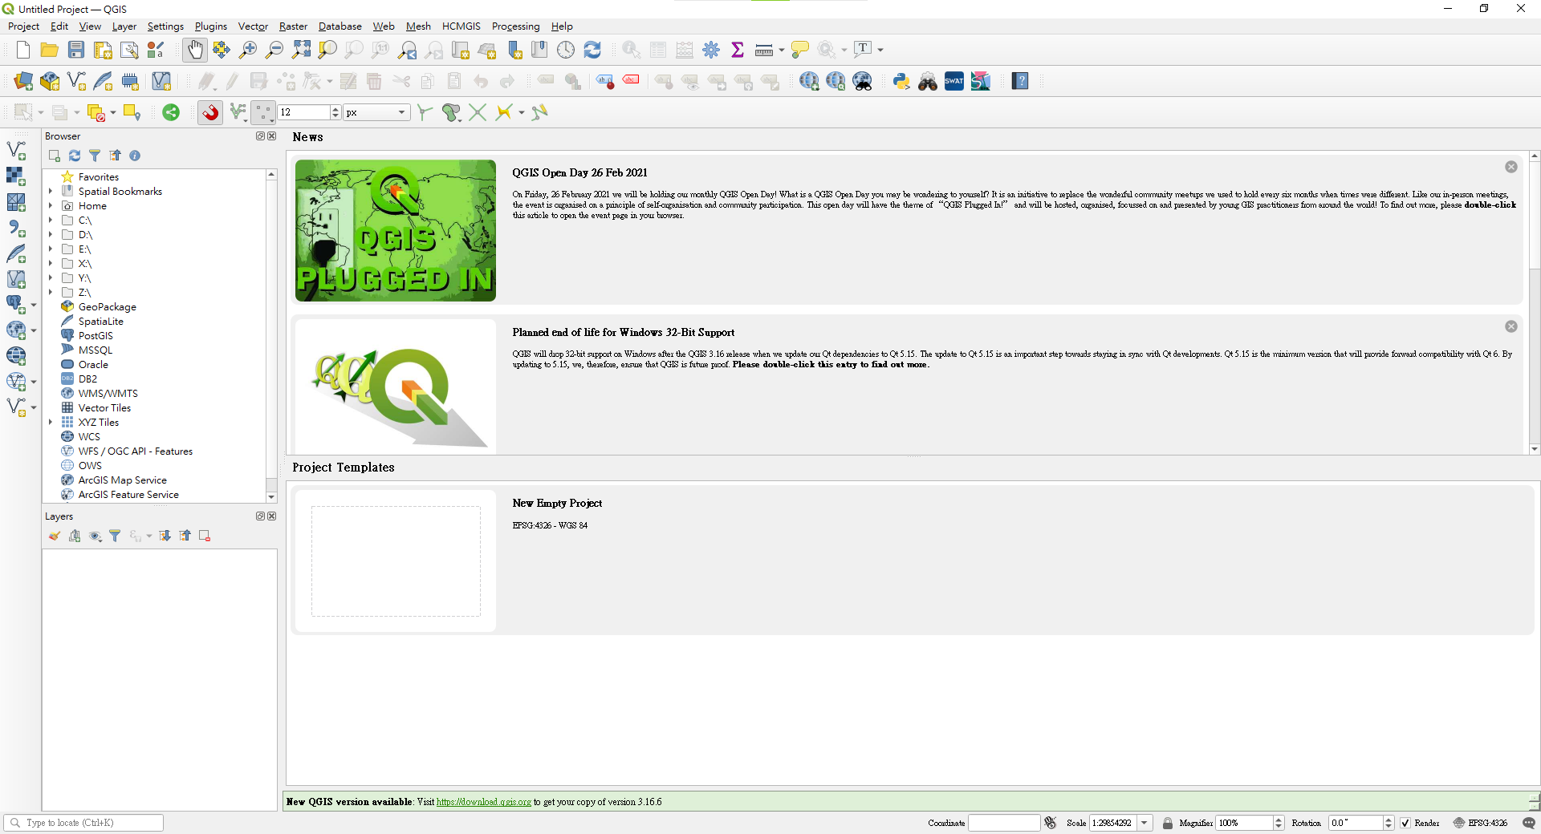

Install STAR-BME
STEP 6: Close QGIS and restart it.

Slide 11
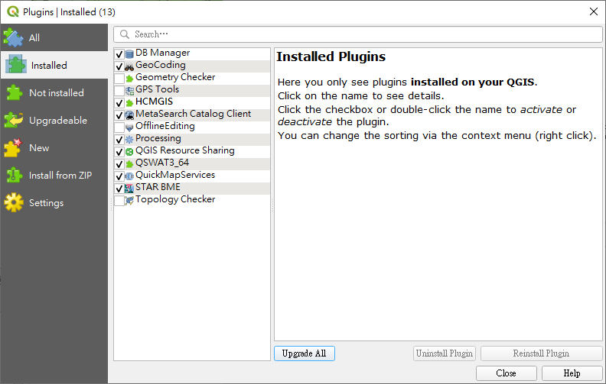
Plugins → Manage and install plugins

Slide 12
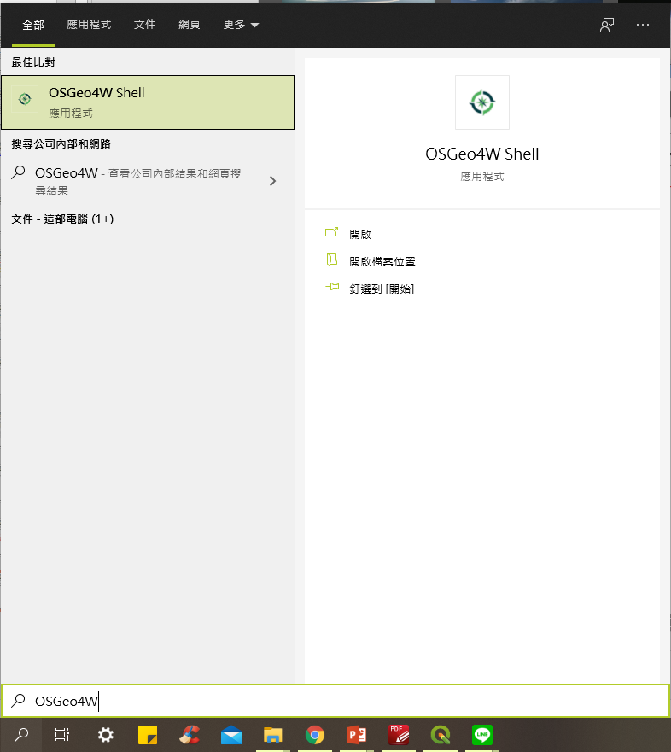
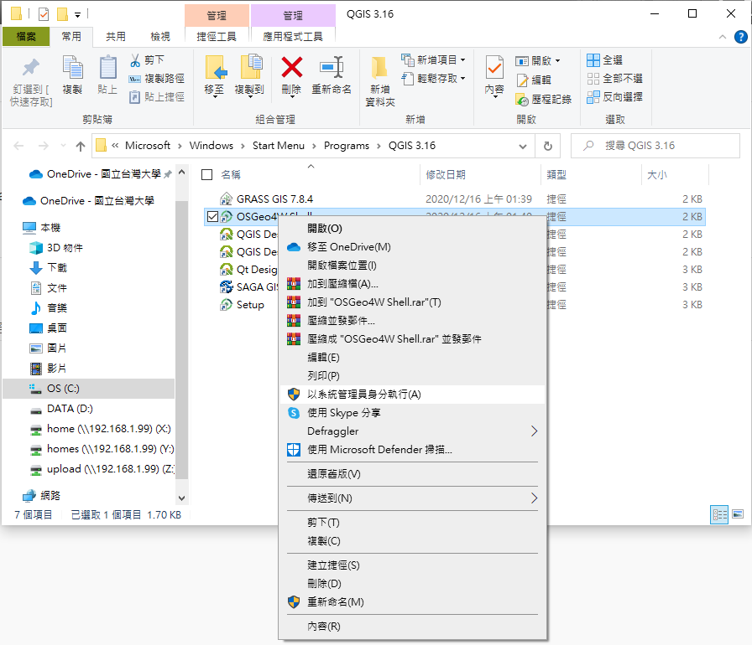
Install STAR-BME (for Windows only)
STEP 7: Install necessary python package
  Search (win + S) OSGeo4W Shell
  Open file location
  Run (OSGeo4W Shell) as administrator
Make sure that OSGeo4W Shell you run is in the folder of QGIS 3.16.

Slide 13
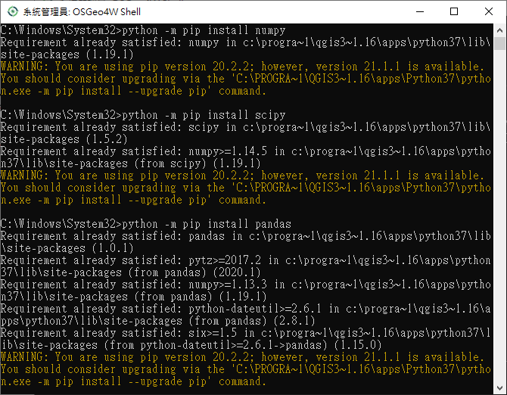
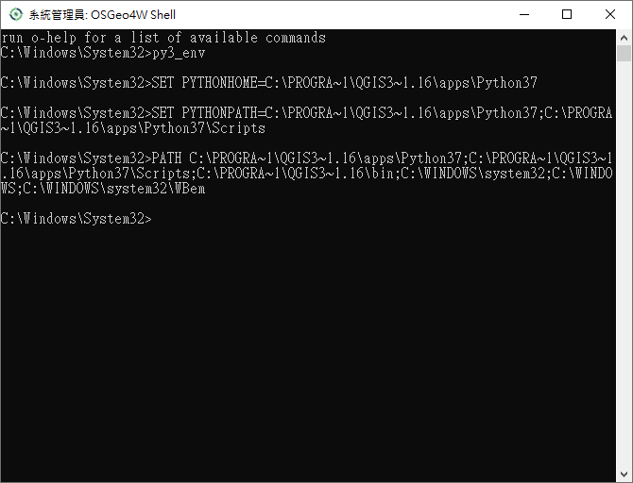
Install STAR-BME (for Windows only)
In the shell:
  Type “py3_env” and enter.
  Type
    python –m pip install numpy
    python –m pip install scipy
    python –m pip install pandas

Slide 14
Install STAR-BME (for Mac only)
STEP 7: Install necessary python package
  Open the “Terminal”
  Type
    /Applications/QGIS.app/Contents/MacOS/
    pip3 install numpy
    pip3 install scipy
    pip3 install pandas

Slide 15
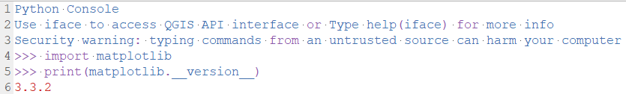
Install STAR-BME
Check the “matplotlib” version (in QGIS)
  Plugins → Python console
  Type
    import matplotlib
    print(matplotlib.__version__)
The “matplotlib” version should be 3.4.* or lower.

Slide 16
Install STAR-BME – for matplotlib higher than 3.4.*
(Windows) In the OSGeo4W Shell,
  python –m pip uninstall matplotlib
  Then, python –m pip install matplotlib==3.4
(Mac) In the Terminal,
  pip3 uninstall matplotlib
  pip3 install matplotlib==3.4

Slide 17
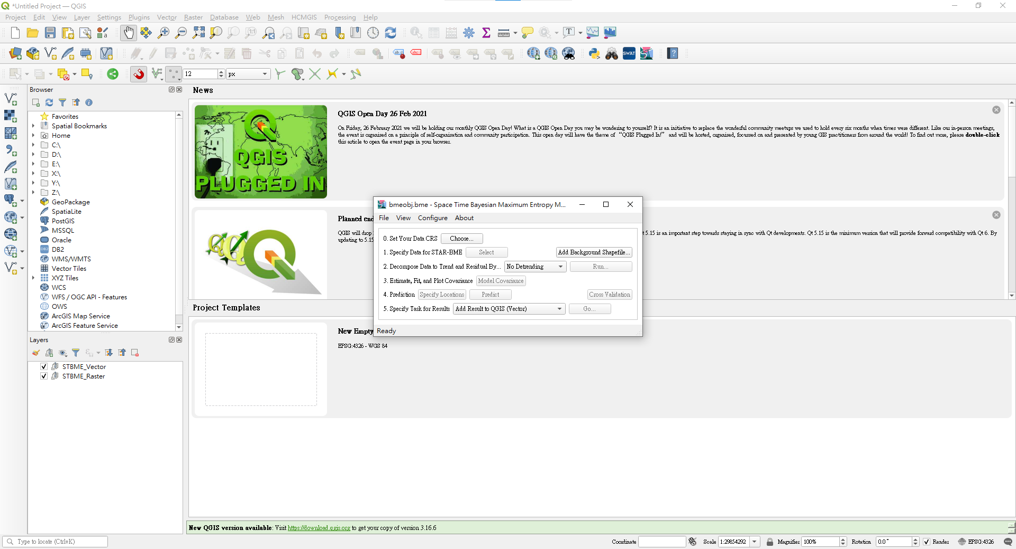
Install STAR-BME
STEP 8: Close QGIS and restart it.

Slide 18
DEMO
Data:
  HardDate.csv: PM10 in Taipei (13 stations, 48 months, 2004~2007)
  SoftDate.csv: Observation interval (13 points, PDF[uniform distribution])

Slide 19
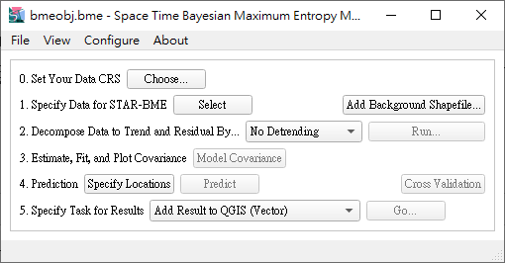
DEMO – STEP 1
Set the CRS
  EPGS: 3826

Slide 20
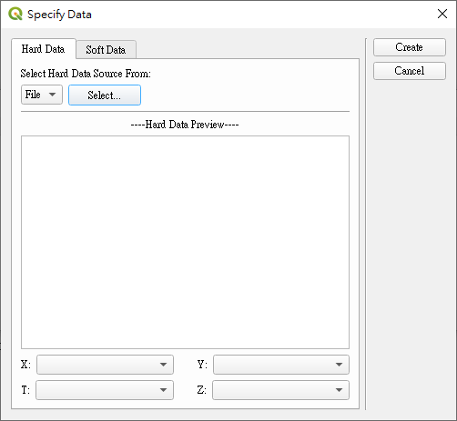
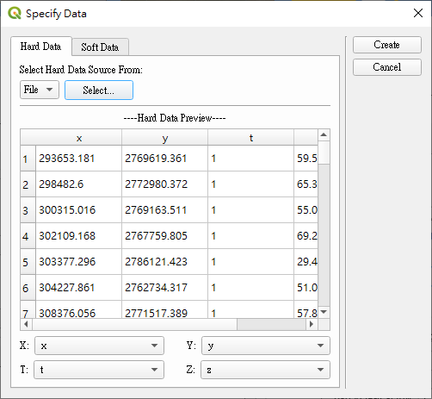
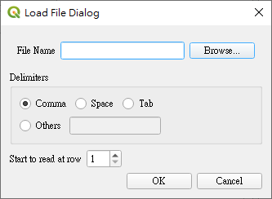
DEMO – STEP 2
Import hard data

Slide 21
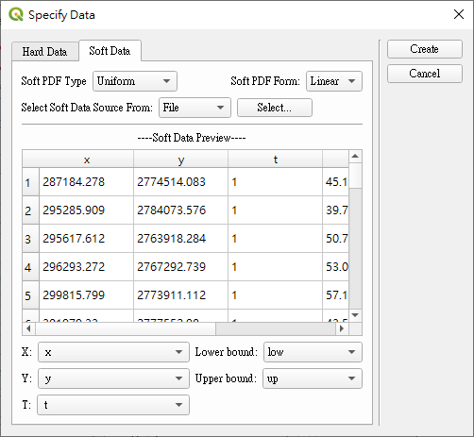
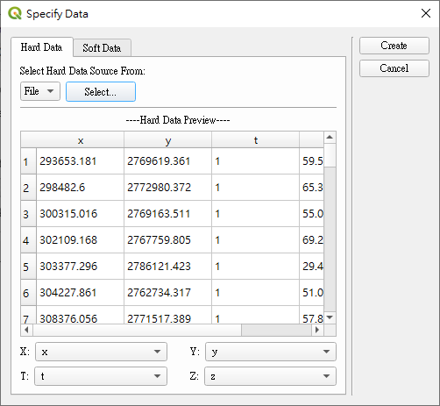
DEMO – STEP 3
Import soft data
Uniform

Slide 22
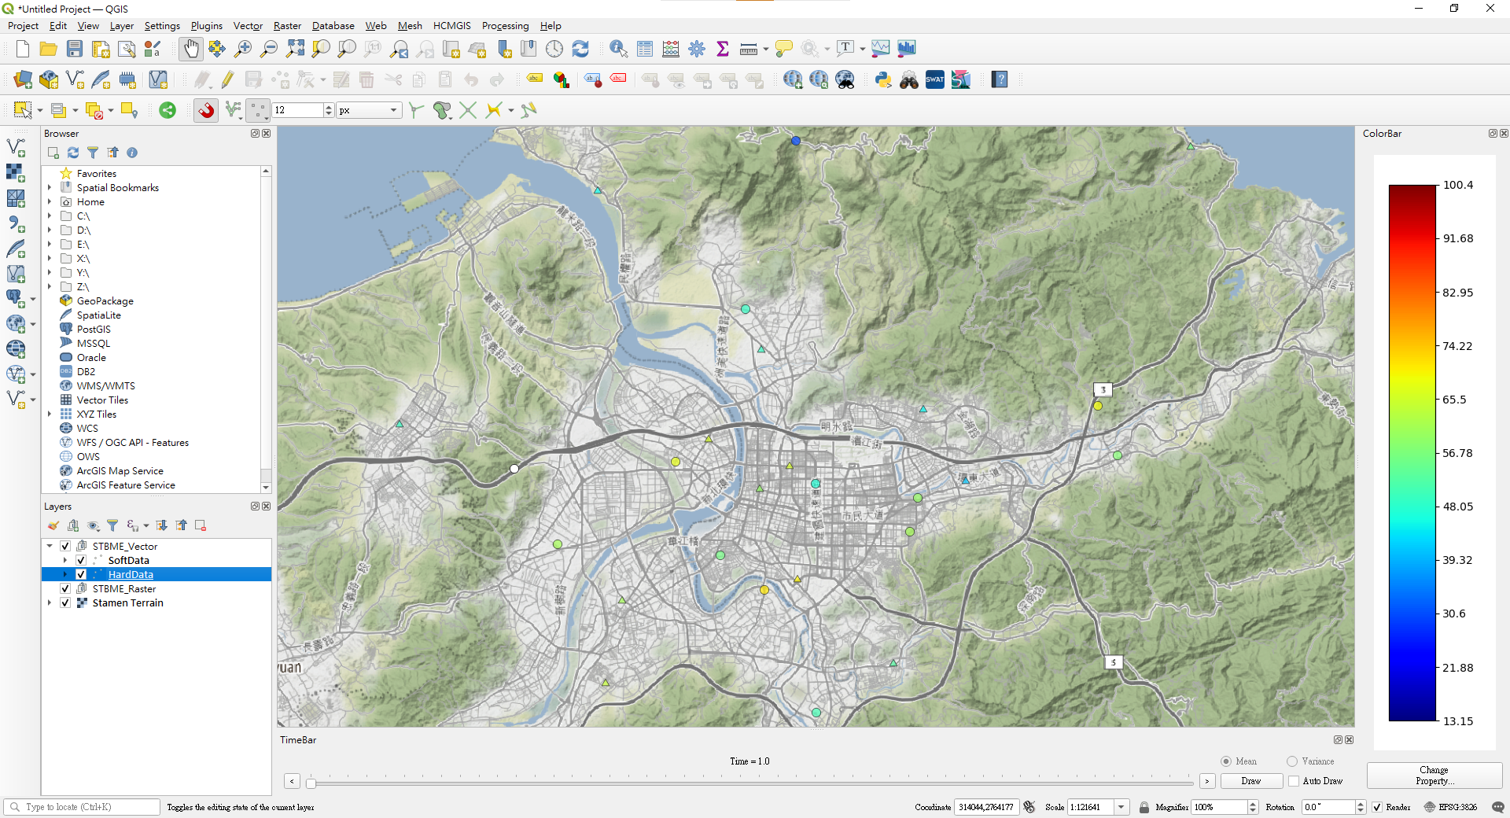

Slide 23
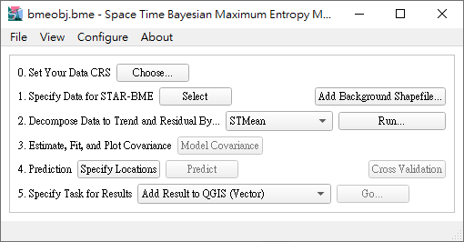
DEMO – STEP 4
Detrend
STMean

Slide 24
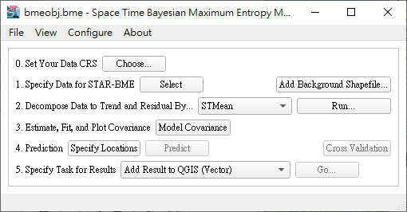
DEMO – STEP 5
Fit the covariance model

Slide 25
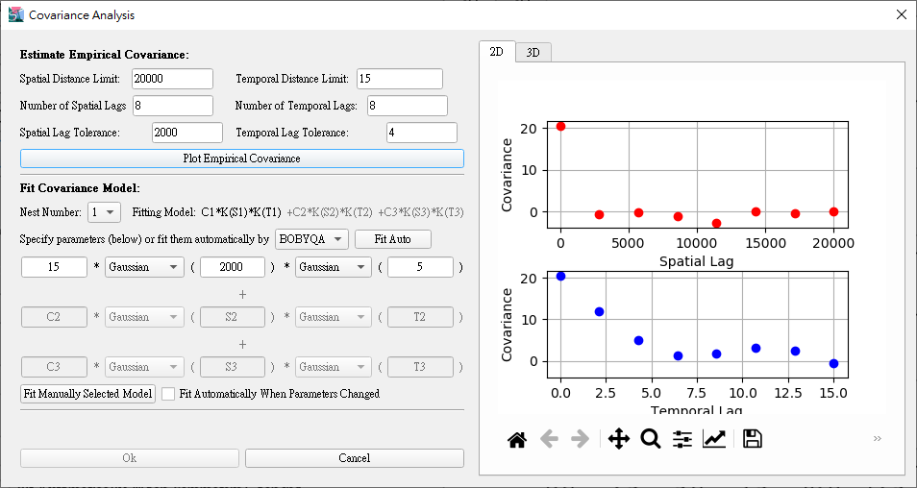
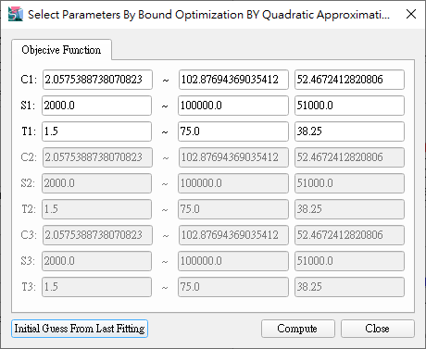
20000
15
8
8
2000
4

Slide 26
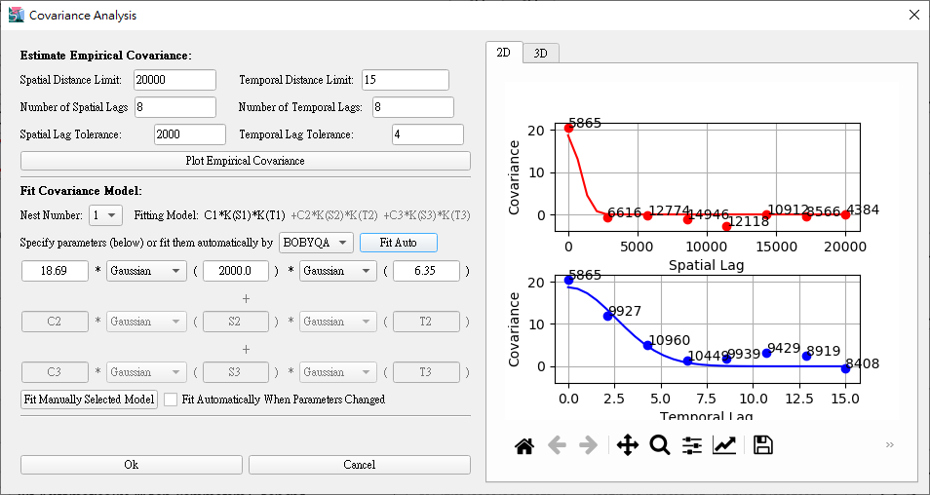

Slide 27
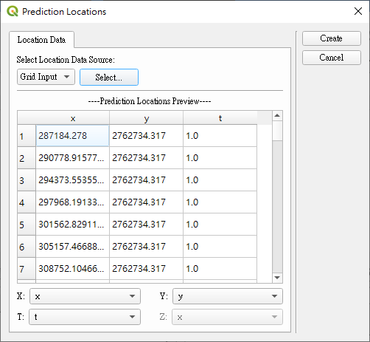
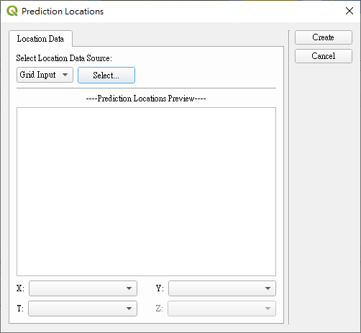

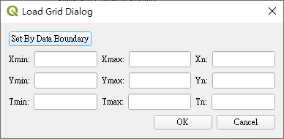
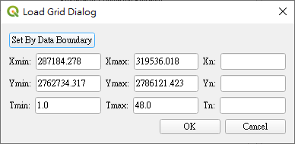
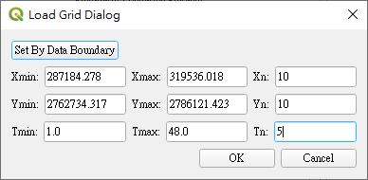
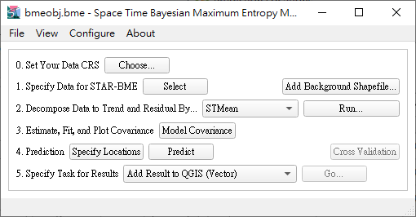
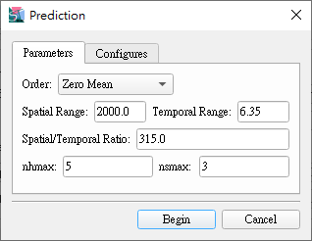
DEMO – STEP 6
Prediction
Grid Input
10
10
5

Slide 28
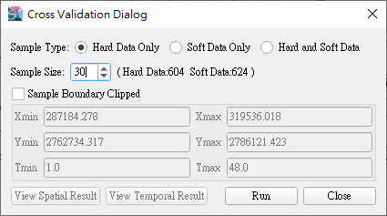
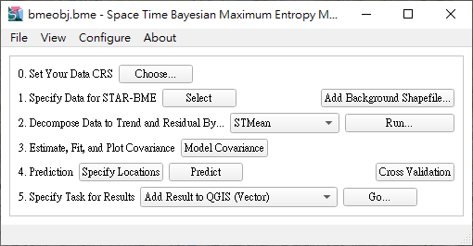
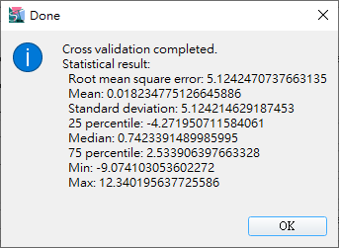
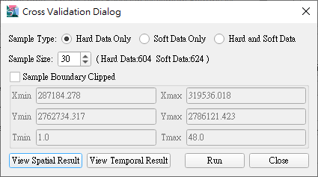
DEMO – STEP 7
Cross Validation
30

Slide 29
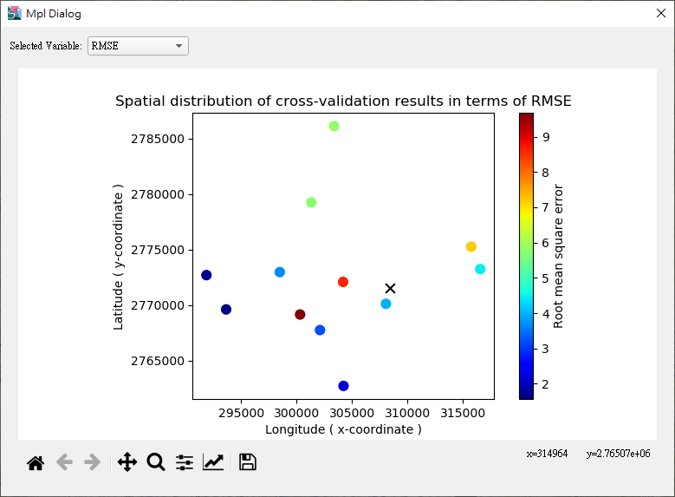
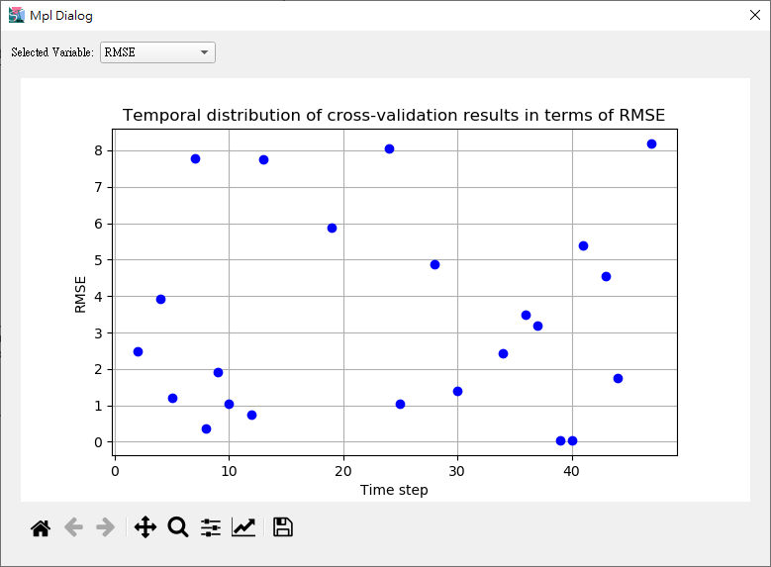

Slide 30
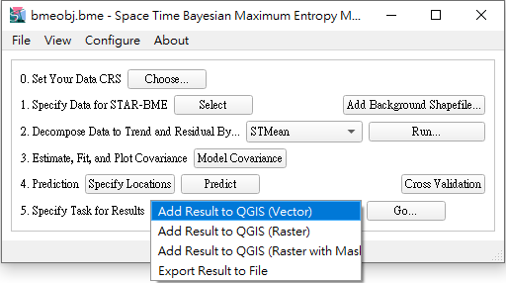
DEMO – STEP 8
Show the result (different options)

Slide 31
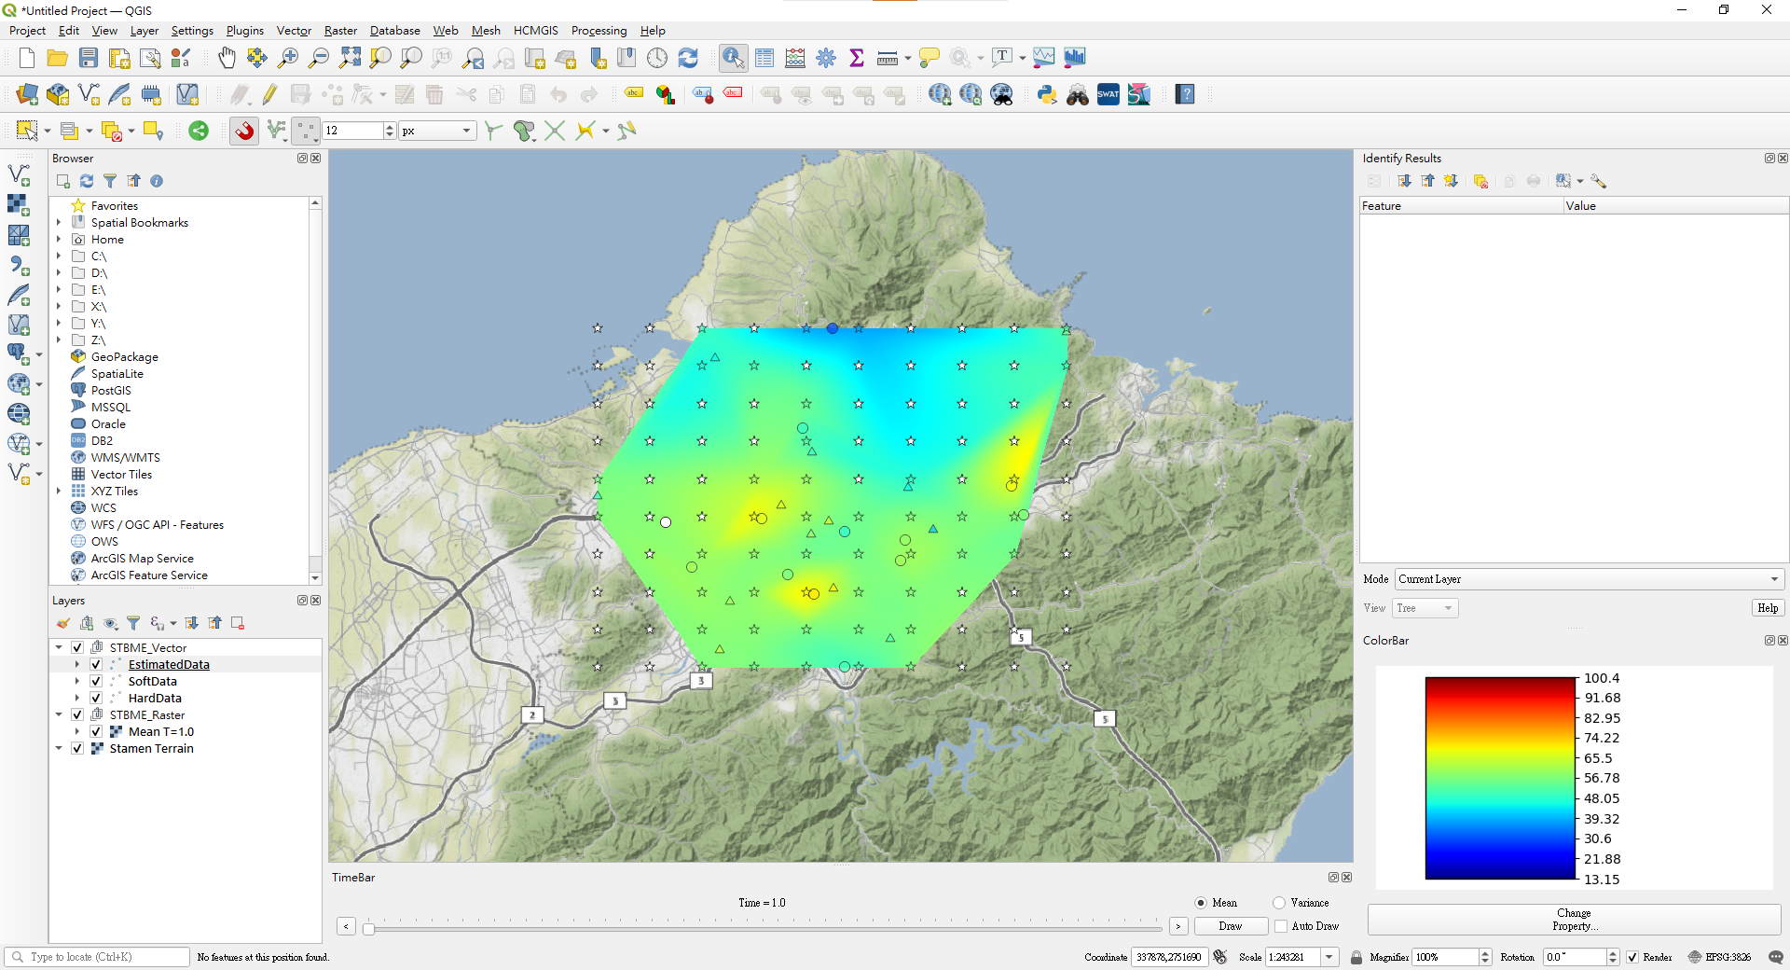

Slide 32
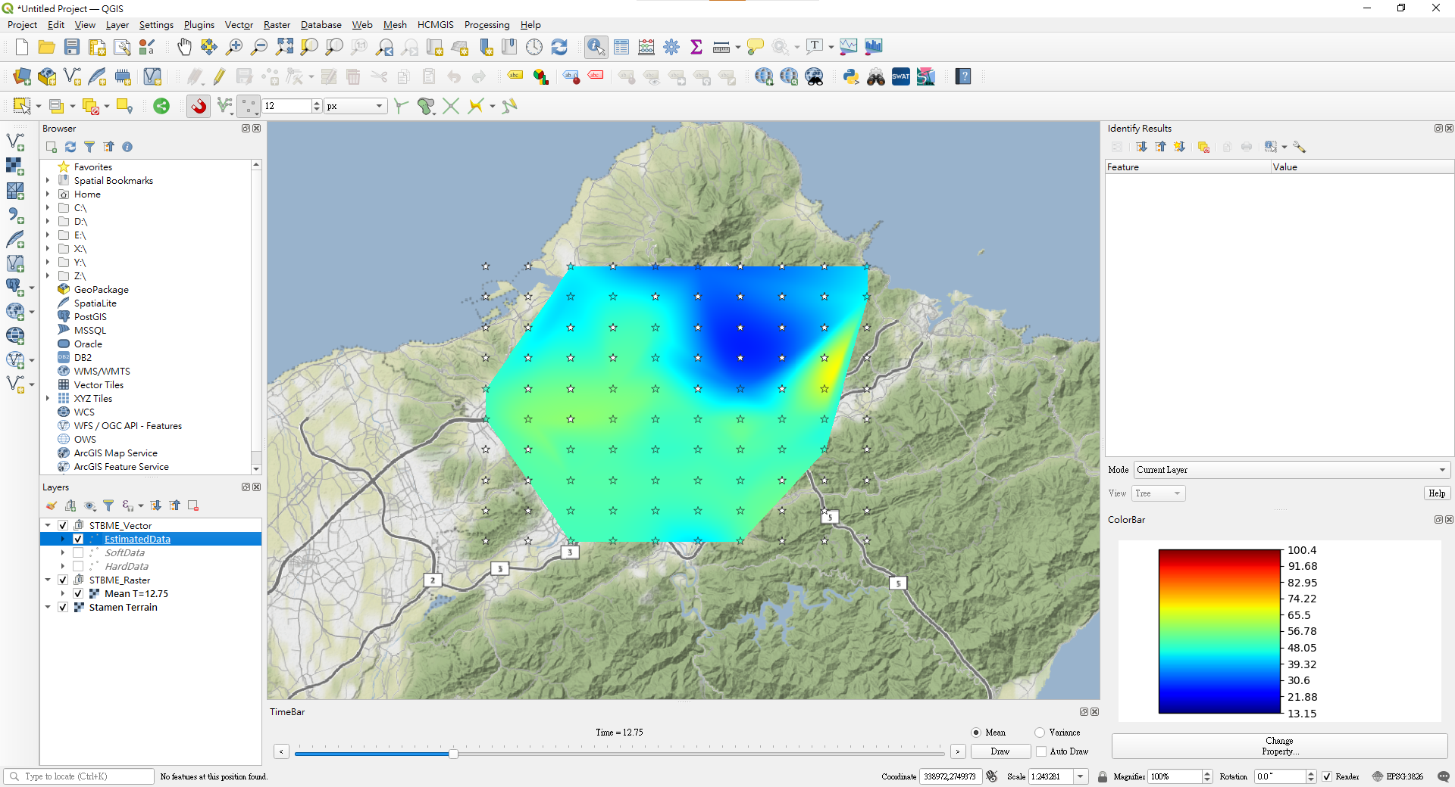

Slide 33
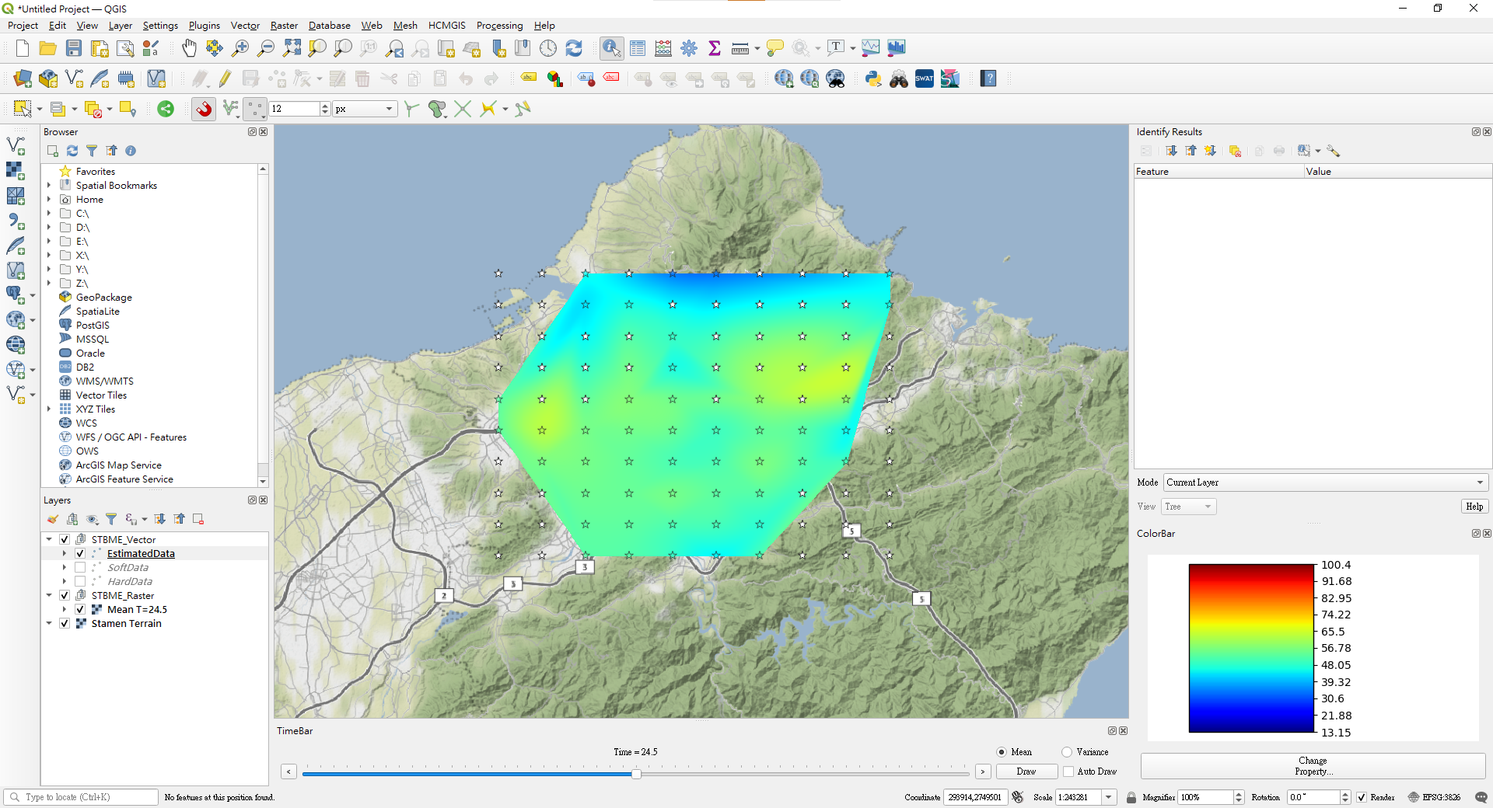

Slide 34
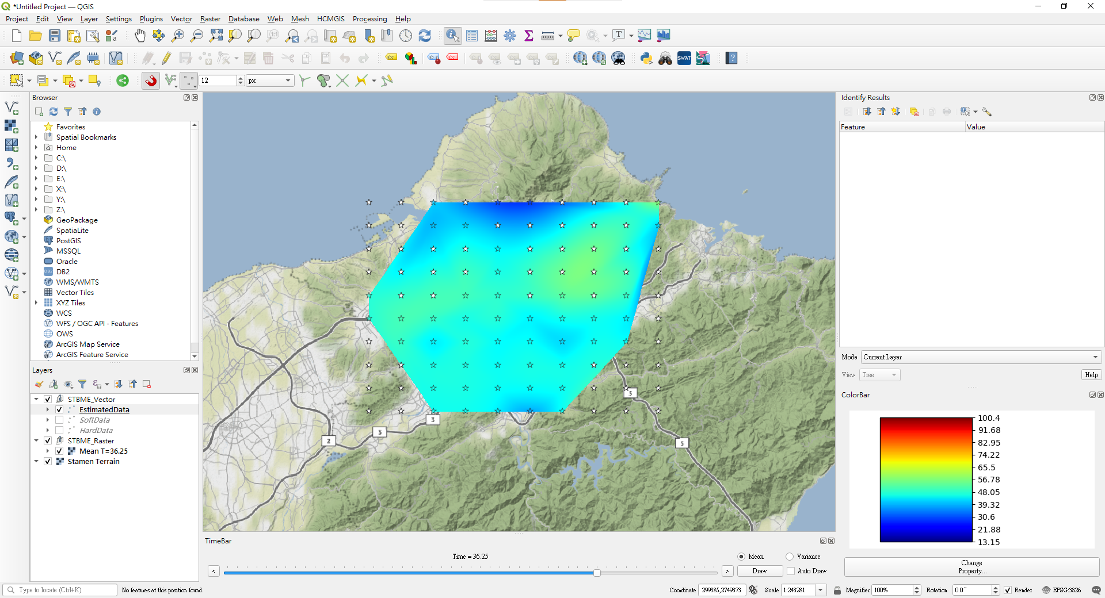

Slide 35
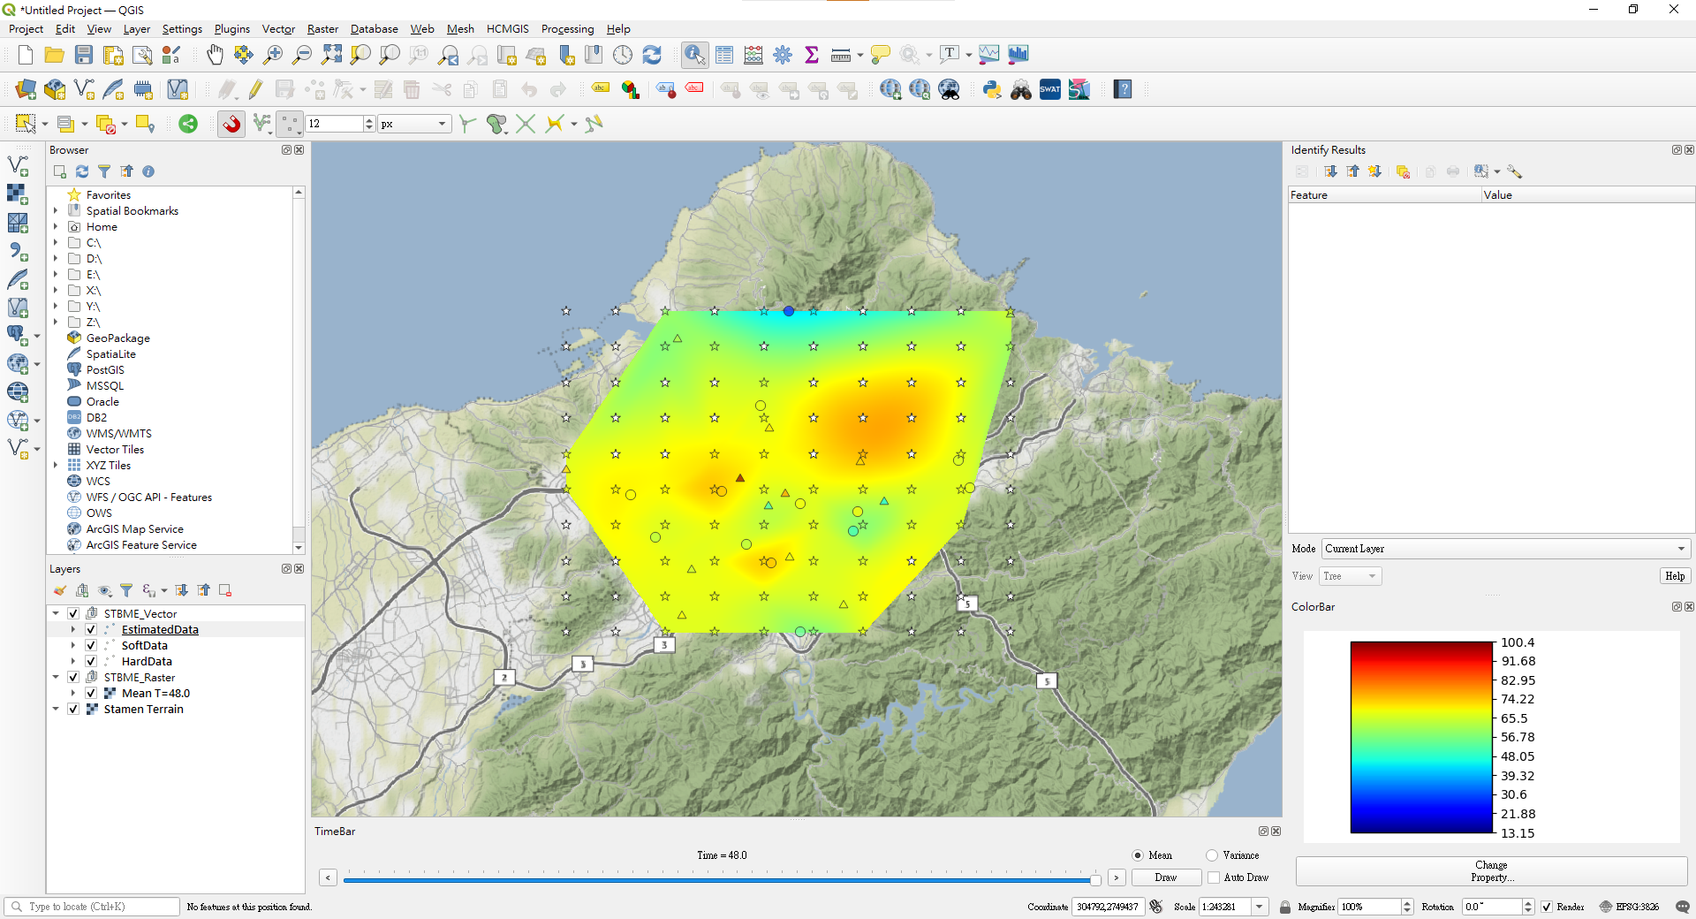

Slide 36
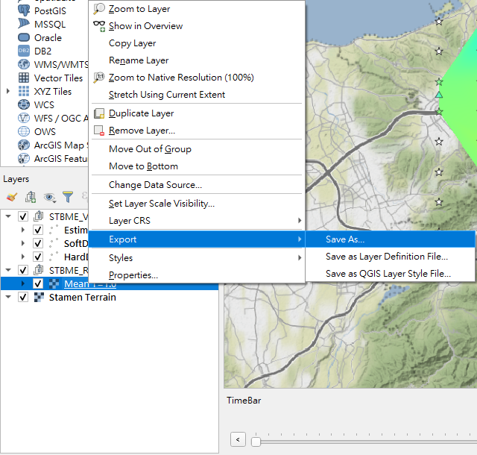

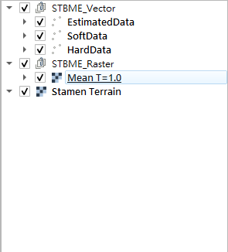
Export the result

